Slide 1

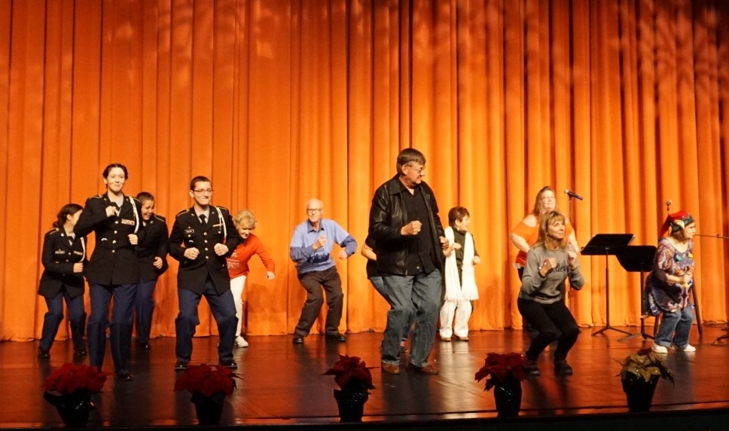
Newsletter
Richmond County Aging Services
225 South Lawrence Street
Rockingham, NC 28379
Phone: 910-997-4491
Fax: 910-410-1136
January 2018
Email: jacqueline.welch@richmondnc.com
www.richmondnc.com
A
39th Annual Senior Christmas Party
Michelle Parrish with United Way along side David Adeimy leads the much anticipated chicken dance. They are joined by JROTC Cadets, Aging Services and DSS Staff as well as seniors.
Upcoming Trips
Senior Center | Trip Location | Date | Time Leaving | Cost
East Rockingham | Moore County Hair Day | Tuesday, Jan. 23rd | 8:00 am | Free
Ellerbe | Moore County Hair Day | Wednesday, Jan. 31st | 8:30 am | Free
1

Slide 2


Upcoming Closings
East Rockingham Senior Center | East Rockingham Meal Site | Ellerbe Senior Center/ Meal Site | Hamlet Meal Site | Rockingham Senior Center
Monday, Jan. 1st | Monday, Jan. 1st | Monday, Jan. 1st | Monday, Jan.1st | Monday, Jan. 1st
Monday, Jan. 15th | Monday, Jan. 15th | Monday, Jan. 15th | Wednesday, Jan. 10th | Monday, Jan. 15th
 |  | Wednesday, Jan 31st | Monday, Jan. 15th
“ For last year’s words belong to last year’s language and
next year’s words await another voice.
And to make an end is to make a beginning.”
(Little Gidding)”
- T.S. Eliot
2

Slide 3


Riddle Me This
What can you catch, but not throw?
I’m the beginning of eternity; the end of time and space; the beginning of every end; and the end of every place. What am I?
What is the only type of cheese that is made backward?
You will survive if I’m stolen or given away, yet you cannot live without me. What am I?
Answers on page 4
Rock of Love Fundraiser Winners
1st place- Wayne McIntyre
2nd place- Ashlee Swinney
3rd place- Dennis Rape
4th place- Jack Walker
5th place- Joyce A. Lisk
On behalf of Aging Services, we would like to thank everyone who participated in our fundraiser. We sold 195 tickets raising $1,950.00. All funds will go back into our programs and activities helping to keep costs low to seniors. Thank you again to our sponsors.
3

Slide 4

Did you know?
SERVICES OFFERED AT RICHMOND COUNTY AGING SERVICES Realizing the importance of social interaction and physical activity to the vitality of all people, Richmond County Aging Services places special emphasis on this and can provide information and assistance. Call 910-997-4491 for more information. Some of the social and recreational activities hosted by the Center(s) include:
Health Screenings | Medicaid Benefits
Fitness and Health Promotions | Medicare Parts A & B
Insurance Counseling | Medicare Part D
Tax Preparation Counseling | Social Security Benefits
Legal Services | Job Training
General Transportation | Job Placement
Medical Transportation | Congregate Meals
Support Groups or Classes for Caregivers | Home Delivered Meals
Housing Assistance | Adult Day Care/ Day Health
Reverse Mortgage Counseling | Mental Health
Home Repair/ Modification | Disaster Preparedness, Planning or Response
Home Health Services | Durable Medical Equipment/ Assistive Devices
In Home Aide Services | Hospice Care
Long Term Care Facilities | Rehabilitation Services
Report Suspected Abuse, Neglect or Exploitation | Respite
Senior Games | Telephone Reassurance
Energy Assistance | Food Distribution
Answers from page 3
A cold
The letter E
Edam
Your heart
Our newsletter, monthly activity calendars, and meal site menus are available on-line at: http://www.richmondnc.com/245/
Aging-Services
4

Slide 5
Th
Collard Green Gumbo with Ham Hock
Cook time | 1 Hour
Serves | 4
Tender collard greens flavored with ham hock, onion, green pepper, celery, and red pepper make up this thick and flavorful gumbo. Serve over brown rice for an all-time favorite meal any night of the week.
Nutritional Facts
Calcium | 62 mg
Calories | 134
Carbohydrate | 17 g
Cholesterol | 7 g
Dietary Fiber | 3 g
Fat | 2.5
Fiber | 7g
Iron | 1 mg
Potassium | 1 mg
Protein | 4 g
Sat fat | 1 g
Sodium | 183 mg
Sugars | 2 g
Ingredients
2 | Tablespoons Vegetable Oil
1 | Large Onion (peeled and diced)
3 | Celery Stalks (chopped)
2 | Cloves Garlic (peeled and minced)
1 | Teaspoon dried thyme
½ | Teaspoon Chopped Red Pepper Flakes
½ | Teaspoon Salt
½ | Teaspoon dried oregano
2 | Tablespoons Whole Wheat Flour
4 | Cups Water
6 | Cups Chopped Collard Greens
2 | Pounds Ham Hock
2 | Cups Cooked Brown Rice
1. Put a skillet on the stove and turn the heat to medium. When it is hot, add the oil. Add the onion, bell pepper, celery, garlic, thyme, red pepper flakes, salt and oregano, and cook until golden, about 20 minutes. 2. Add flour in small amounts, sprinkling a little bit at a time and stirring well, until it turns slightly brown, about 10 minutes. 3. Slowly, add the water, stirring constantly. 4. Add the collard greens and cook until tender, about 45 minutes. 5. Divide the brown rice between 4 shallow bowls and top each with about 1 cup of gumbo. Notes: one medium size chicken sausage link can substituted for a ham hock
Directions
Find recipe at www.usda.gov/whatcooking
The Richmond County Cooperative Extension’s goal is to provide the residents of the community with research-based knowledge. For more information on food safety, health, wellness, and nutrition please contact the Family and Consumer Sciences Agent, Janice Roberts, MS at 910-997-8255.

Slide 6
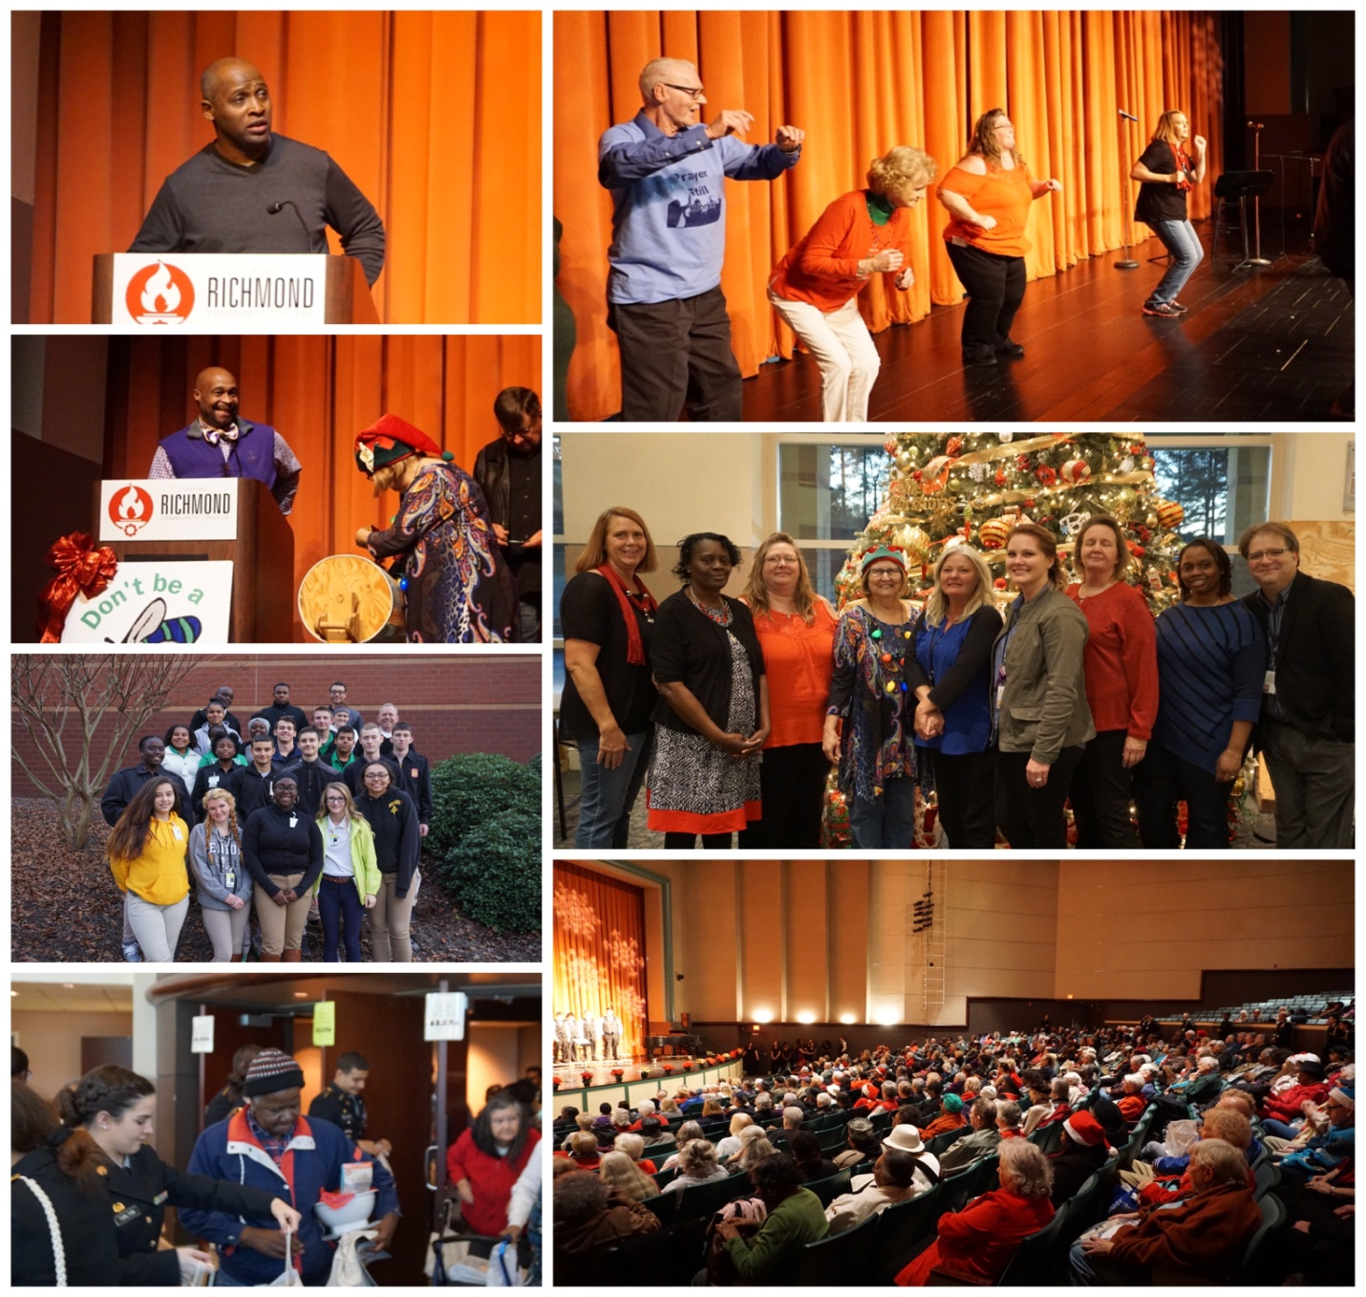

39th Annual Senior Christmas Party 12-13-17

